Slide 1


Unsupervised Learning and Anomaly Detection
16
PART III · MACHINE LEARNING CORE
CHAPTER 16 · WEEK 9
Data Science — From Foundations to Intelligent Systems
LECTURER
Dr. Mustafa Hameed
THE ISLAMIA UNIVERSITY OF BAHAWALPUR
Bahawalpur, Pakistan
Department of Information Technology · BSIT · Fall 2026
Notes:
Chapter 16: Unsupervised Learning and Anomaly Detection. Part 3 — Machine Learning Core. Week 9: Features and ensembles; unsupervised (mostly revision). Handout pages 101–108.

Slide 2

Where this chapter sits
THE COURSE
PART I
PART II
PART III
PART IV
PART V
PART VI
1
2
3
4
5
6
7
8
9
10
11
12
13
14
15
16
17
18
19
20
21
22
23
24
25
26
27
28
29
30
31
32
Unsupervised Learning and Anomaly Detection
BUILDS ON
USED LATER IN
Ch 4 The Mathematical Toolkit
Ch 25 Data Science for the Internet of Things
Ch 14 Model Evaluation and Selection
Ch 26 Data Science for Cybersecurity
Data Science · Chapter 16 · Unsupervised Learning and Anomaly Detection
Handout p. 101 2
Notes:
Place the chapter. Before you start: Chapter 4 (distance and scaling — clustering is distance, so unscaled features will decide your clusters for you) and Chapter 14. Revision note: clustering and PCA revise Machine Learning Fall 2026, Chapters 15 and 16; anomaly detection is genuinely new.

Slide 3

What you will be able to do
LEARNING OUTCOMES
By the end of this chapter you will be able to:
1
Run and interpret k-means, hierarchical and density-based clustering, and choose between them.
2
Select the number of clusters using the elbow and silhouette methods.
3
Explain what PCA does and read a scree plot.
4
Choose an anomaly detection method appropriate to the data and the definition of “anomalous”.
5
Evaluate unsupervised results despite having no labels.
Data Science · Chapter 16 · Unsupervised Learning and Anomaly Detection
Handout p. 101 3
Notes:
Read these out: they are the chapter's contract with the room. Each click adds one.

Slide 4

Vocabulary for this chapter
KEY TERMS
clustering
k-means
centroid
inertia
elbow method
silhouette score
hierarchical clustering
dendrogram
DBSCAN
dimensionality reduction
PCA
explained variance
t-SNE / UMAP
anomaly detection
isolation forest
association rules
Each term is defined where it first matters — not here.
Data Science · Chapter 16 · Unsupervised Learning and Anomaly Detection
Handout p. 101 4
Notes:
Do not define these now; they arrive one at a time. This slide is for the students' notes. Terms: clustering; k-means; centroid; inertia; elbow method; silhouette score; hierarchical clustering; dendrogram; DBSCAN; dimensionality reduction; PCA; explained variance; t-SNE / UMAP; anomaly detection; isolation forest; association rules.

Slide 5

In this chapter
IN THIS CHAPTER
16.1
Learning Without Answers
p. 101 ›
16.2
k-Means Clustering
p. 101 ›
16.3
Hierarchical Clustering and DBSCAN
p. 102 ›
16.4
Dimensionality Reduction
p. 103 ›
16.5
Anomaly Detection
p. 104 ›
Data Science · Chapter 16 · Unsupervised Learning and Anomaly Detection
Handout pp. 101–108 5
Notes:
The route through the chapter. Each row is a link: click it to jump to that section in the slide show.

Slide 6

Learning Without Answers
KEY IDEA
Unsupervised learning finds structure when no labels exist. That describes most real data: nobody has labelled which of your 12,000 accounts are compromised, or which students form meaningful behavioural groups. This chapter is also the direct technical foundation of Chapter 26, where the anomaly is the target.
Data Science · Chapter 16 · Unsupervised Learning and Anomaly Detection
§16.1 · Handout p. 101 6
Notes:
Say this in your own words first; the slide is the handout's wording.

Slide 7
k-Means Clustering
SECTION 2 OF 5
16.2
16.1 Learning Without Answers
16.2 k-Means Clustering
16.3 Hierarchical Clustering and DBSCAN
16.4 Dimensionality Reduction
16.5 Anomaly Detection
Data Science · Chapter 16
Handout §16.2 7
Notes:
Pause. Name the question this section answers.

Slide 8

k-Means
DEFINITION
Choose k. Place k centroids at random. Repeat until stable: (1) assign each point to its nearest centroid; (2) move each centroid to the mean of its assigned points. It minimises inertia — the total squared distance from points to their own centroid.
Data Science · Chapter 16 · Unsupervised Learning and Anomaly Detection
§16.2 · Handout p. 101 8
Notes:
Read the box aloud, then ask for an example from the room before moving on.

Slide 9
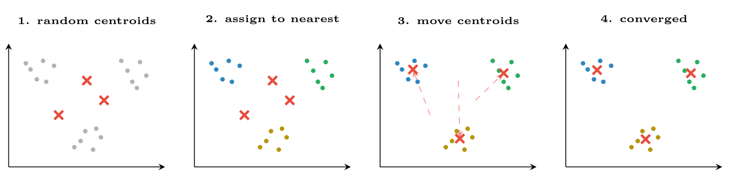
k-means in four steps
FIGURE 16.1
Assignment and update alternate until nothing moves. Because the starting positions are random, different runs can converge differently — which is why n_init exists and why you should fix the random seed.
Data Science · Chapter 16 · Unsupervised Learning and Anomaly Detection
§16.2 · Handout p. 101 9
Notes:
Figure 16.1 (handout p. 102): k-means in four steps. Assignment and update alternate until nothing moves. Because the starting positions are random, different runs can converge differently — which is why n_init exists and why you should fix the random seed.

Slide 10
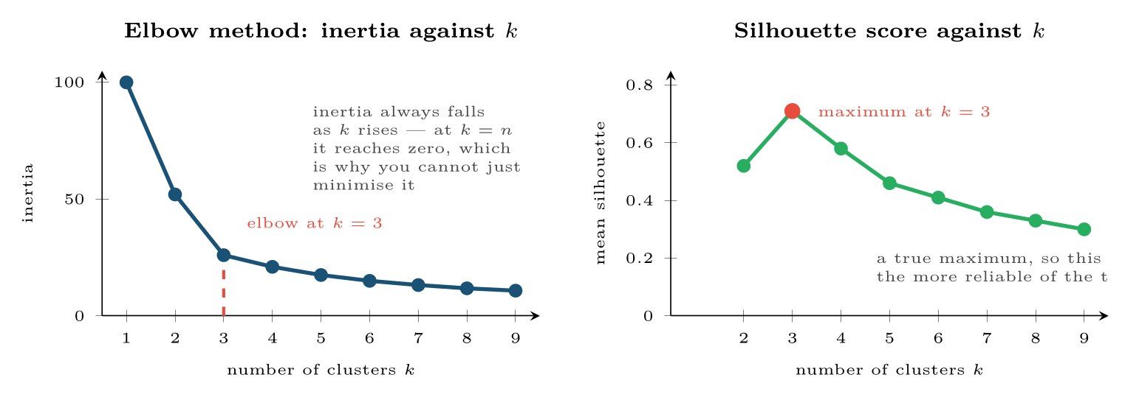
Two ways to choose k
FIGURE 16.2
Inertia falls monotonically, so the elbow is a judgement call; the silhouette score has a true maximum and is the better default. Both should agree with a domain reason for the number you pick.
Data Science · Chapter 16 · Unsupervised Learning and Anomaly Detection
§16.2.1 · Handout p. 102 10
Notes:
Figure 16.2 (handout p. 102): Two ways to choose k. Inertia falls monotonically, so the elbow is a judgement call; the silhouette score has a true maximum and is the better default. Both should agree with a domain reason for the number you pick.

Slide 11
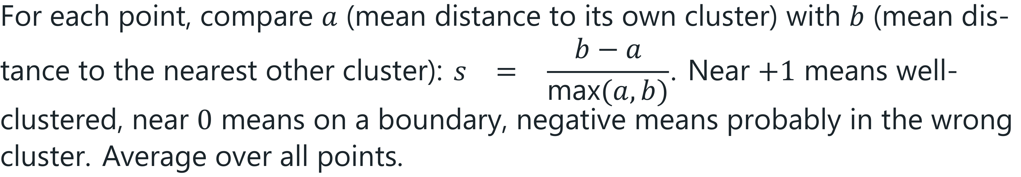
Silhouette Score
DEFINITION
Data Science · Chapter 16 · Unsupervised Learning and Anomaly Detection
§16.2.1 · Handout p. 102 11
Notes:
Read the box aloud, then ask for an example from the room before moving on.

Slide 12
Hierarchical Clustering and DBSCAN
SECTION 3 OF 5
16.3
16.1 Learning Without Answers
16.2 k-Means Clustering
16.3 Hierarchical Clustering and DBSCAN
16.4 Dimensionality Reduction
16.5 Anomaly Detection
Data Science · Chapter 16
Handout §16.3 12
Notes:
Pause. Name the question this section answers.

Slide 13

Hierarchical Clustering and DBSCAN
AT A GLANCE
 | k-means | Hierarchical | DBSCAN
Needs k? | Yes, in advance | No — cut the dendrogram anywhere | No
Cluster shape | Spherical only | Any | Any
Outliers | Forced into a cluster | Forced into a cluster | Labelled as noise
Scales to large n? | Yes | No (O(n²) or worse) | Moderately
Key parameter | k | linkage, cut height | eps, min_samples
Use when | Large data, roughly round groups | You want the hierarchy itself | Irregular shapes, or you need outliers identified
Data Science · Chapter 16 · Unsupervised Learning and Anomaly Detection
§16.3 · Handout p. 102 13
Notes:
Do not read the table row by row: pick the row the room is most likely to get wrong and ask why.

Slide 14

Why DBSCAN Matters for This Course
CONCEPT
DBSCAN defines clusters as dense regions and labels everything else noise. For cybersecurity and IoT that is not a side-effect — it is the output you want. The points k-means would have swept into the nearest cluster are precisely the sessions or devices you were looking for.
Data Science · Chapter 16 · Unsupervised Learning and Anomaly Detection
§16.3 · Handout p. 102 14
Notes:
Read the box aloud, then ask for an example from the room before moving on.

Slide 15
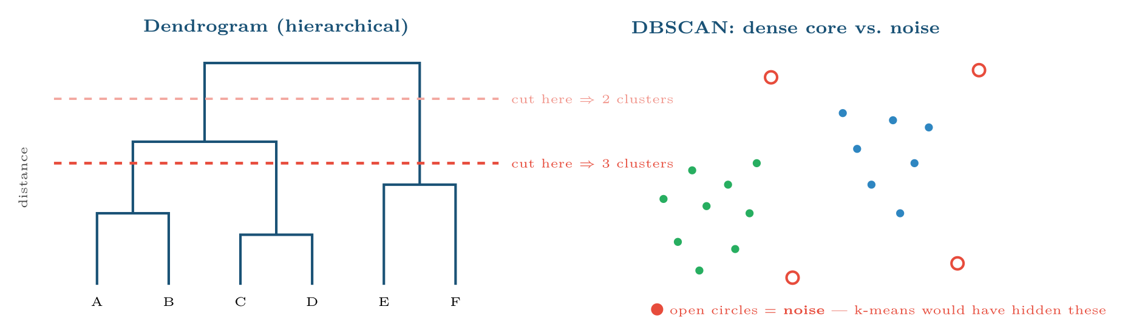
Hierarchical Clustering and DBSCAN
FIGURE 16.3
Left: a dendrogram, where the number of clusters is chosen after the fact by cutting at a chosen height. Right: DBSCAN separates dense regions from noise, which makes it a clustering algorithm and an outlier detector at once.
Data Science · Chapter 16 · Unsupervised Learning and Anomaly Detection
§16.3 · Handout p. 102 15
Notes:
Figure 16.3 (handout p. 103): Left: a dendrogram, where the number of clusters is chosen after the fact by cutting at a chosen height. Right: DBSCAN separates dense regions from noise, which makes it a clustering algorithm and an outlier detector at once.

Slide 16
Dimensionality Reduction
SECTION 4 OF 5
16.4
16.1 Learning Without Answers
16.2 k-Means Clustering
16.3 Hierarchical Clustering and DBSCAN
16.4 Dimensionality Reduction
16.5 Anomaly Detection
Data Science · Chapter 16
Handout §16.4 16
Notes:
Pause. Name the question this section answers.

Slide 17
Principal Component Analysis
DEFINITION
PCA finds new axes — principal components — that are linear combinations of the original features, ordered so that the first captures the most variance, the second the most of what remains, and so on. Keeping the first few gives a lower-dimensional representation that preserves most of the structure.
Data Science · Chapter 16 · Unsupervised Learning and Anomaly Detection
§16.4 · Handout p. 103 17
Notes:
Read the box aloud, then ask for an example from the room before moving on.

Slide 18
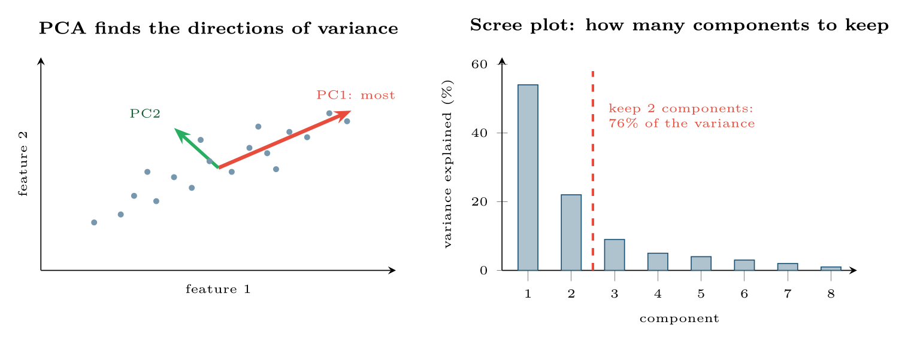
Dimensionality Reduction
FIGURE 16.4
PCA. Left: the components are the directions along which the data actually varies, not the original axes. Right: the scree plot shows where adding components stops buying much, which is how the number to keep is chosen.
Data Science · Chapter 16 · Unsupervised Learning and Anomaly Detection
§16.4 · Handout p. 103 18
Notes:
Figure 16.4 (handout p. 103): PCA. Left: the components are the directions along which the data actually varies, not the original axes. Right: the scree plot shows where adding components stops buying much, which is how the number to keep is chosen.

Slide 19

PCA Requires Scaling, and Destroys Interpretability
WATCH OUT
PCA maximises variance, so an unscaled feature measured in bytes will dominate one measured in seconds regardless of importance — always standardise first. And the components are mixtures: “PC1” has no meaning a stakeholder can act on. Use PCA for compression, visualisation and noise reduction, not when you must explain which feature drove a decision.
Data Science · Chapter 16 · Unsupervised Learning and Anomaly Detection
§16.4 · Handout p. 103 19
Notes:
Read the box aloud, then ask for an example from the room before moving on.

Slide 20
t-SNE and UMAP: For Looking, Not for Modelling
CONCEPT
These produce striking 2-D pictures of high-dimensional data by preserving local neighbourhoods. Two cautions: distances between clusters in the picture are not meaningful, and the layout changes with the random seed and the perplexity setting. Use them to generate hypotheses, never as evidence, and never as features for a downstream model.
Data Science · Chapter 16 · Unsupervised Learning and Anomaly Detection
§16.4 · Handout p. 103 20
Notes:
Read the box aloud, then ask for an example from the room before moving on.

Slide 21
Anomaly Detection
SECTION 5 OF 5
16.5
16.1 Learning Without Answers
16.2 k-Means Clustering
16.3 Hierarchical Clustering and DBSCAN
16.4 Dimensionality Reduction
16.5 Anomaly Detection
Data Science · Chapter 16
Handout §16.5 21
Notes:
Pause. Name the question this section answers.

Slide 22
Anomaly Detection
DEFINITION
Identifying observations that differ markedly from the majority. It is the unsupervised counterpart to the rare-class classification of Chapter 14, used when labelled examples of the rare class are unavailable — which is the norm for novel attacks and for equipment that has not yet failed.
Data Science · Chapter 16 · Unsupervised Learning and Anomaly Detection
§16.5 · Handout p. 104 22
Notes:
Read the box aloud, then ask for an example from the room before moving on.

Slide 23
Anomaly Detection
AT A GLANCE
Method | Idea | Best for
Statistical (z, IQR) | Beyond 3σ or 1.5×IQR | Single variables that are roughly normal. Fails badly on long tails (Chapter 5)
Distance / k-NN | Far from its nearest neighbours | Moderate dimensions; needs scaling
Density (LOF, DBSCAN) | In a sparse region relative to its neighbourhood | Clusters of differing density
Isolation Forest | Randomly split; anomalies get isolated in few splits | The strong default — fast, scales well, high dimensions
Autoencoder | Train to reconstruct normal data; high reconstruction error = anomaly | Complex or sequential data (Chapter 18)
Time-series residual | Forecast the next value; large error = anomaly | Telemetry and log volumes (Chapter 19)
Data Science · Chapter 16 · Unsupervised Learning and Anomaly Detection
§16.5 · Handout p. 104 23
Notes:
Do not read the table row by row: pick the row the room is most likely to get wrong and ask why.

Slide 24

Evaluating Clusters Without Labels
WORKED EXAMPLE
You cluster 12,000 user accounts into k=4 and must decide whether the result is useful. There are no labels, so accuracy is unavailable.
1. Internal validity. Silhouette = 0.61. Above about 0.5 the structure is reasonably well separated. Compare against k=3 and k=5.
2. Stability. Re-run on a random 80% subsample, five times. If cluster memberships shuffle wildly between runs, the structure is an artefact of the sample, not of the population. This test is skipped far too often.
3. Profile the clusters. Compute the mean of every feature per cluster and compare against the overall mean. Cluster 3 has 4× the failed-login rate, 2× the distinct destination ports and half the session duration.
Data Science · Chapter 16 · Unsupervised Learning and Anomaly Detection
§16.5 · Handout p. 104 24
Notes:
Each click adds one step of the working. Ask for the next number before you reveal it.

Slide 25
Evaluating Clusters Without Labels (continued)
WORKED EXAMPLE
4. External validation — the decisive test. Do the clusters relate to something you did not cluster on? If cluster 3 also contains 70% of the accounts later confirmed compromised, the clustering has found something real.
Verdict: steps 1–2 say the clusters are statistically sound; steps 3–4 say whether they are useful. A clustering can pass the first pair and fail the second, in which case it is a mathematically valid answer to a question nobody asked.
Data Science · Chapter 16 · Unsupervised Learning and Anomaly Detection
§16.5 · Handout p. 104 25
Notes:
Each click adds one step of the working. Ask for the next number before you reveal it.

Slide 26





Four lenses: Finding Structure Without Labels
FOUR LENSES
LEARNING ANALYTICS
PROJECT MANAGEMENT
Cluster students on engagement patterns to discover learner types — steady, bursty, front-loaded, disengaging — which no one had defined in advance and which support different interventions.
Cluster past projects to find natural categories of work, giving better reference classes for estimation than the official project taxonomy.
INTERNET OF THINGS
CYBERSECURITY
Cluster devices by behavioural signature to find fleet sub-populations that need different maintenance regimes.
This is the chapter’s home domain.
Data Science · Chapter 16 · Unsupervised Learning and Anomaly Detection
Handout p. 108 26
Notes:
The same method, four domains. Each of the next four slides opens one lens in full.

Slide 27

Learning Analytics: Finding Structure Without Labels
FOUR LENSES
LEARNING ANALYTICS
Project Management
Cluster students on engagement patterns to discover learner types — steady, bursty, front-loaded, disengaging — which no one had defined in advance and which support different interventions. Use k-means with silhouette selection, then profile each cluster in plain language. Ethical caution: these clusters must never become permanent labels attached to students (Chapter 28); they describe a semester’s behaviour, not a person.
Internet of Things
Cybersecurity
Data Science · Chapter 16 · Unsupervised Learning and Anomaly Detection
Handout p. 108 27
Notes:
Learning Analytics. Cluster students on engagement patterns to discover learner types — steady, bursty, front-loaded, disengaging — which no one had defined in advance and which support different interventions. Use k-means with silhouette selection, then profile each cluster in plain language. Ethical caution: these clusters must never become permanent labels attached to students (Chapter 28); they describe a semester’s behaviour, not a person.

Slide 28

Project Management: Finding Structure Without Labels
FOUR LENSES
PROJECT MANAGEMENT
Learning Analytics
Cluster past projects to find natural categories of work, giving better reference classes for estimation than the official project taxonomy. With only dozens of projects, hierarchical clustering is preferable to k-means — the dendrogram itself is the useful output, because a manager can see why two projects were grouped and overrule it.
Internet of Things
Cybersecurity
Data Science · Chapter 16 · Unsupervised Learning and Anomaly Detection
Handout p. 108 28
Notes:
Project Management. Cluster past projects to find natural categories of work, giving better reference classes for estimation than the official project taxonomy. With only dozens of projects, hierarchical clustering is preferable to k-means — the dendrogram itself is the useful output, because a manager can see why two projects were grouped and overrule it.

Slide 29

Internet of Things: Finding Structure Without Labels
FOUR LENSES
INTERNET OF THINGS
Learning Analytics
Cluster devices by behavioural signature to find fleet sub-populations that need different maintenance regimes. More importantly, use isolation forests on window features for anomaly detection: you cannot supervise a failure mode that has never occurred, and this is the standard approach when there are no positive labels at all. Establish each device’s own baseline — fleet-wide thresholds miss a device that is abnormal only for itself.
Project Management
Cybersecurity
Data Science · Chapter 16 · Unsupervised Learning and Anomaly Detection
Handout p. 108 29
Notes:
Internet of Things. Cluster devices by behavioural signature to find fleet sub-populations that need different maintenance regimes. More importantly, use isolation forests on window features for anomaly detection: you cannot supervise a failure mode that has never occurred, and this is the standard approach when there are no positive labels at all. Establish each device’s own baseline — fleet-wide thresholds miss a device that is abnormal only for itself.

Slide 30

Cybersecurity: Finding Structure Without Labels
FOUR LENSES
CYBERSECURITY
Learning Analytics
This is the chapter’s home domain. Unsupervised methods detect novel attacks that no signature covers — precisely what supervised models trained on past attacks cannot do. Use DBSCAN or isolation forests for user and entity behaviour analytics, scoring each account against its own 30-day profile. Remember the base rate from Chapter 6: an anomaly score is not a verdict, and tuning contamination too high will bury your analysts.
Project Management
Internet of Things
Data Science · Chapter 16 · Unsupervised Learning and Anomaly Detection
Handout p. 108 30
Notes:
Cybersecurity. This is the chapter’s home domain. Unsupervised methods detect novel attacks that no signature covers — precisely what supervised models trained on past attacks cannot do. Use DBSCAN or isolation forests for user and entity behaviour analytics, scoring each account against its own 30-day profile. Remember the base rate from Chapter 6: an anomaly score is not a verdict, and tuning contamination too high will bury your analysts.

Slide 31

Try it yourself: Cluster, Reduce, Detect
TRY IT YOURSELF
WHAT YOU WILL DO
1. Choose k by silhouette, not by eye
2. Stability check: do the clusters survive resampling?
3. PCA for visualisation and for the scree plot
4. Anomaly detection with no labels at all
THIS WEEK'S LAB
WHAT YOU WILL RUN
Week 9: Engineer, ensemble, interpret; cluster & detect
1 listing, 34 lines of Python
Data Science · Chapter 16 · Unsupervised Learning and Anomaly Detection
§16.5 · Handout p. 104 31
Notes:
Say what the room will have at the end of the lab, then let them start. Circulate rather than lecture.

Slide 32
Cluster, Reduce, Detect
LAB · STEP 1 OF 5
Set-up
Python
1
2
3
4
5
6
7
8
import numpy as np, matplotlib.pyplot as plt
from sklearn.preprocessing import StandardScaler
from sklearn.cluster import KMeans, DBSCAN
from sklearn.decomposition import PCA
from sklearn.ensemble import IsolationForest
from sklearn.metrics import silhouette_score
Xs = StandardScaler().fit_transform(X) # MANDATORY -- clustering is distance
Data Science · Chapter 16 · Unsupervised Learning and Anomaly Detection
§16.5 · Handout p. 104 32
Notes:
Step 1: Set-up. Read the code aloud; ask what each line would print before running it.

Slide 33
Cluster, Reduce, Detect
LAB · STEP 2 OF 5
Choose k by silhouette, not by eye
Python
9
10
11
12
# --- choose k by silhouette, not by eye --------------------------------
for k in range(2, 9):
km = KMeans(n_clusters=k, n_init=10, random_state=0).fit(Xs)
print(f"k={k} inertia={km.inertia_:9.1f} silhouette={silhouette_score(Xs, km.labels_):.3f}")
Data Science · Chapter 16 · Unsupervised Learning and Anomaly Detection
§16.5 · Handout p. 104 33
Notes:
Step 2: Choose k by silhouette, not by eye. Read the code aloud; ask what each line would print before running it.

Slide 34
Cluster, Reduce, Detect
LAB · STEP 3 OF 5
Stability check: do the clusters survive resampling?
Python
13
14
15
16
17
18
# --- stability check: do the clusters survive resampling? --------------
rng = np.random.default_rng(0)
for _ in range(3):
idx = rng.choice(len(Xs), size=int(0.8*len(Xs)), replace=False)
km2 = KMeans(n_clusters=4, n_init=10, random_state=0).fit(Xs[idx])
print(" subsample silhouette:", round(silhouette_score(Xs[idx], km2.labels_), 3))
Data Science · Chapter 16 · Unsupervised Learning and Anomaly Detection
§16.5 · Handout p. 104 34
Notes:
Step 3: Stability check: do the clusters survive resampling?. Read the code aloud; ask what each line would print before running it.

Slide 35
Cluster, Reduce, Detect
LAB · STEP 4 OF 5
PCA for visualisation and for the scree plot
Python
19
20
21
22
# --- PCA for visualisation and for the scree plot ----------------------
p = PCA().fit(Xs)
print("variance explained:", (p.explained_variance_ratio_[:5]*100).round(1))
proj = PCA(n_components=2).fit_transform(Xs)
Data Science · Chapter 16 · Unsupervised Learning and Anomaly Detection
§16.5 · Handout p. 104 35
Notes:
Step 4: PCA for visualisation and for the scree plot. Read the code aloud; ask what each line would print before running it.

Slide 36
Cluster, Reduce, Detect
LAB · STEP 5 OF 5
Anomaly detection with no labels at all
Python
23
24
25
26
27
28
29
30
# --- anomaly detection with no labels at all ---------------------------
iso = IsolationForest(contamination=0.01, random_state=0).fit(Xs)
score = -iso.score_samples(Xs) # higher = more anomalous
top = np.argsort(score)[::-1][:20]
print("20 most anomalous rows:", top)
plt.scatter(proj[:,0], proj[:,1], s=6, c=score, cmap="viridis")
plt.colorbar(label="anomaly score"); plt.xlabel("PC1"); plt.ylabel("PC2"); plt.show()
Data Science · Chapter 16 · Unsupervised Learning and Anomaly Detection
§16.5 · Handout p. 104 36
Notes:
Step 5: Anomaly detection with no labels at all. Read the code aloud; ask what each line would print before running it.

Slide 37

Why does inertia always fall as k increases, and what does that imply about using it alone to choose k?
CHECKPOINT 1 OF 3
Discuss with the person next to you, then advance.
Data Science · Chapter 16 · Unsupervised Learning and Anomaly Detection
Handout p. 108 · answers in Appendix D 37
Notes:
Ask the room. Do not advance until someone commits to an answer.

Slide 38

Why does inertia always fall as k increases, and what does that imply about using it alone to choose k?
CHECKPOINT 1 OF 3 · ANSWER
Because more centroids can only reduce the distance from each point to its nearest one; at k=n inertia is zero. Minimising it therefore always chooses the largest k, so it must be combined with the elbow judgement, the silhouette score, and a domain reason.
Data Science · Chapter 16 · Unsupervised Learning and Anomaly Detection
Handout p. 108 · answers in Appendix D 38
Notes:
Answer (Appendix D): Because more centroids can only reduce the distance from each point to its nearest one; at k=n inertia is zero. Minimising it therefore always chooses the largest k, so it must be combined with the elbow judgement, the silhouette score, and a domain reason.

Slide 39
You need clusters of irregular shape and want outliers identified rather than absorbed. Which algorithm, and why not k-means?
CHECKPOINT 2 OF 3
Discuss with the person next to you, then advance.
Data Science · Chapter 16 · Unsupervised Learning and Anomaly Detection
Handout p. 108 · answers in Appendix D 39
Notes:
Ask the room. Do not advance until someone commits to an answer.

Slide 40
You need clusters of irregular shape and want outliers identified rather than absorbed. Which algorithm, and why not k-means?
CHECKPOINT 2 OF 3 · ANSWER
DBSCAN. k-means assumes roughly spherical clusters and forces every point into one, so the outliers you want identified would be absorbed into the nearest cluster and hidden.
Data Science · Chapter 16 · Unsupervised Learning and Anomaly Detection
Handout p. 108 · answers in Appendix D 40
Notes:
Answer (Appendix D): DBSCAN. k-means assumes roughly spherical clusters and forces every point into one, so the outliers you want identified would be absorbed into the nearest cluster and hidden.

Slide 41
PCA on unscaled data returns a first component that is almost entirely one feature. What happened?
CHECKPOINT 3 OF 3
Discuss with the person next to you, then advance.
Data Science · Chapter 16 · Unsupervised Learning and Anomaly Detection
Handout p. 108 · answers in Appendix D 41
Notes:
Ask the room. Do not advance until someone commits to an answer.

Slide 42
PCA on unscaled data returns a first component that is almost entirely one feature. What happened?
CHECKPOINT 3 OF 3 · ANSWER
The unscaled feature with the largest variance — typically the one with the biggest units — dominated. PCA maximises variance, which is scale-dependent. Standardise first.
Data Science · Chapter 16 · Unsupervised Learning and Anomaly Detection
Handout p. 108 · answers in Appendix D 42
Notes:
Answer (Appendix D): The unscaled feature with the largest variance — typically the one with the biggest units — dominated. PCA maximises variance, which is scale-dependent. Standardise first.

Slide 43

What to take away
CHAPTER SUMMARY
1
k-means is fast and requires k in advance; it assumes spherical clusters and forces every point into one.
2
Choose k by silhouette (which has a true maximum) supported by the elbow and by a domain reason.
3
Hierarchical clustering gives a dendrogram you can cut anywhere; DBSCAN finds arbitrary shapes and labels noise explicitly.
4
PCA re-expresses data along directions of maximum variance; the scree plot says how many components to keep. Scale first; expect to lose interpretability.
5
t-SNE and UMAP are for looking, not for modelling.
6
Isolation forests are the strong default for anomaly detection when no labels exist. Validate clusters by internal score, stability, profiling and an external variable.
Data Science · Chapter 16 · Unsupervised Learning and Anomaly Detection
Handout p. 108 43
Notes:
Ask the room to say each takeaway before you reveal it.

Slide 44

Quick check 1 of 2
REVIEW · MULTIPLE CHOICE
Which algorithm explicitly labels points as noise?
A
k-means
B
PCA
C
DBSCAN
D
hierarchical clustering
Data Science · Chapter 16 · Unsupervised Learning and Anomaly Detection
Handout p. 108 44
Notes:
Take a show of hands for each option before discussing. (The handout does not print MCQ answers.)

Slide 45
Quick check 2 of 2
REVIEW · MULTIPLE CHOICE
A silhouette score of −0.2 for a point means:
A
it is well clustered
B
it is on a boundary
C
it is probably in the wrong cluster
D
it is an outlier
Data Science · Chapter 16 · Unsupervised Learning and Anomaly Detection
Handout p. 108 45
Notes:
Take a show of hands for each option before discussing. (The handout does not print MCQ answers.)

Slide 46
For your notebook
REVIEW QUESTIONS
SHORT
Explain why PCA requires standardised features.
SHORT
Give two reasons not to use a t-SNE plot as evidence in a report.
SHORT
Why is unsupervised anomaly detection the right tool for novel attacks, when supervised classification is not?
APPLIED
You cluster 8,000 IoT devices and get four clusters with silhouette 0.44. Describe the full validation procedure you would run before presenting the result, including what would make you discard it.
APPLIED
A scree plot shows components explaining 41%, 19%, 14%, 6%, 5%, 4%, … of variance. How many components would you keep and why? What would you check before using the reduced representation in a model that must be explained to auditors?
Data Science · Chapter 16 · Unsupervised Learning and Anomaly Detection
Handout p. 108 46
Notes:
Set these for independent study. Model answers are not printed in the handout.

Slide 47
End of Chapter 16
16
NEXT
READ
Chapter 17 — Neural Network Foundations
Handout Chapter 16, pages 101–108
THIS WEEK'S LAB
ASSESSMENT
Engineer, ensemble, interpret; cluster & detect
Assignment 2 set
Data Science · Chapter 16 · Unsupervised Learning and Anomaly Detection
47
Notes:
Close. NEXT: Chapter 17 — Neural Network Foundations. READ: Handout Chapter 16, pages 101–108. THIS WEEK'S LAB: Engineer, ensemble, interpret; cluster & detect. ASSESSMENT: Assignment 2 set.

